Slide 1
Data Warrior
Lingbin Ni
Aug.9,2017

Slide 2
Data Import
Simple value insertion
1)INSERT INTO table_name VALUES (1, 2, 3);
2)START TRANSACTION;
INSERT INTO table VALUES (1, 2, 3);
...
COMMIT;
Parallel data insertion
1)COPY INTO table from 'file' USING DELIMITERS '|','\n';

Slide 3

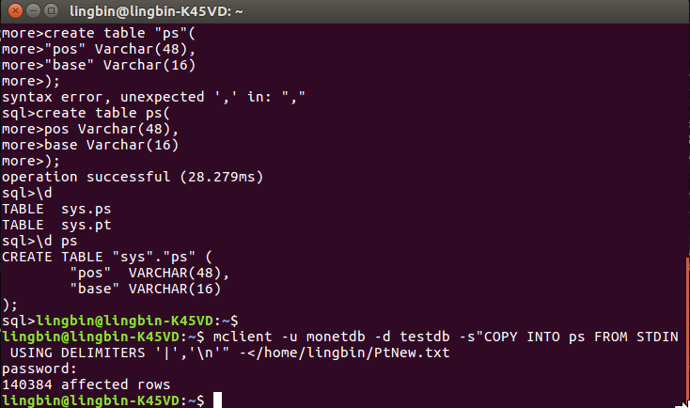
Data Import

Slide 4
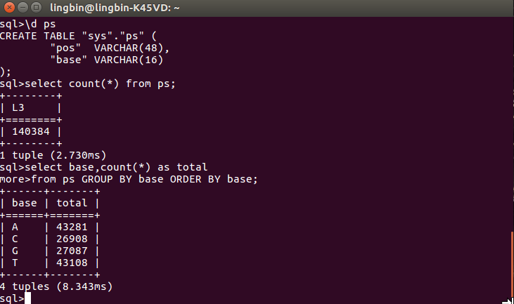
Data Import

Slide 5
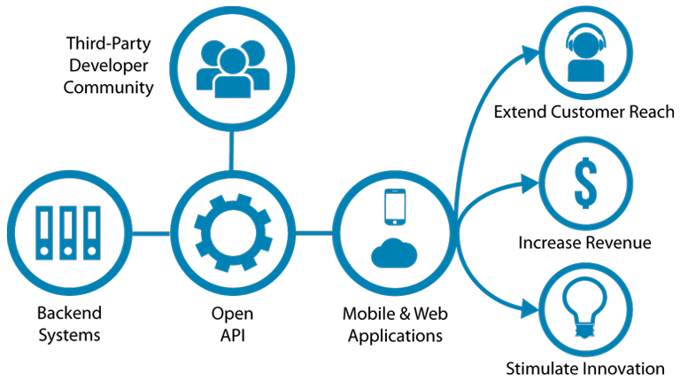
API
What’s API?

Slide 6
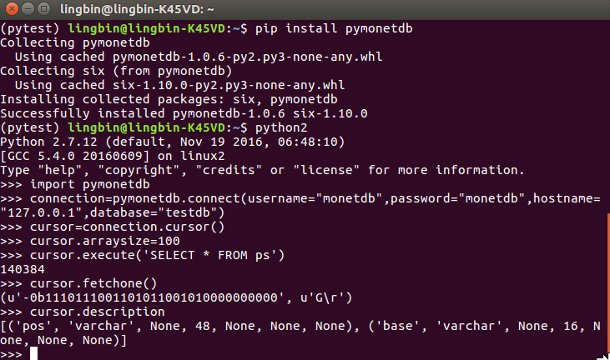
API

Slide 7
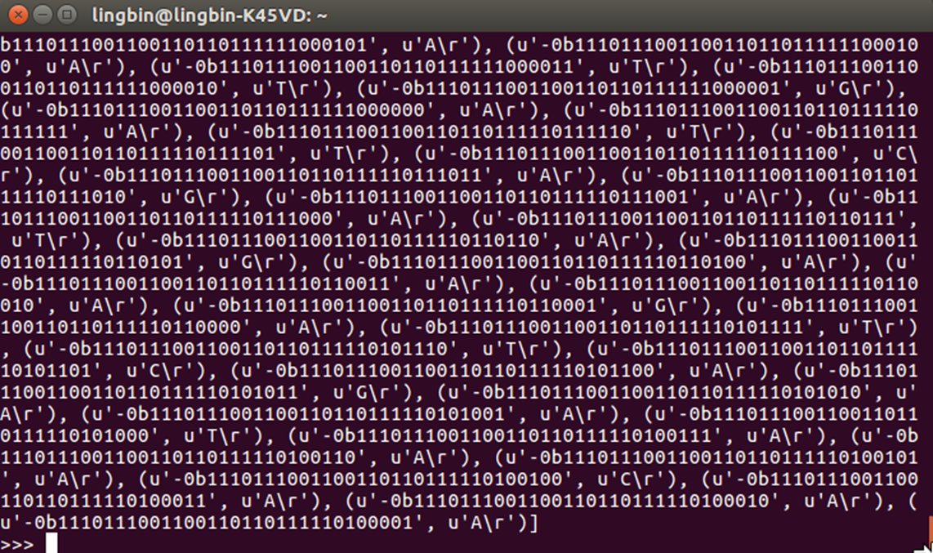
API

Slide 8
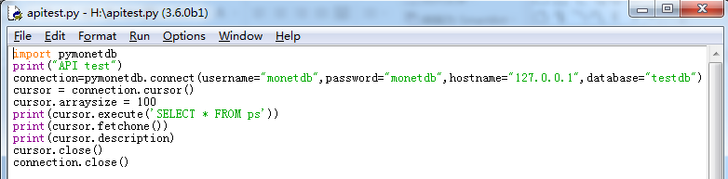
API
Another shortcut

Slide 9
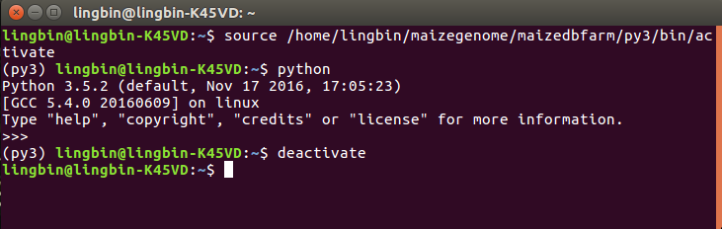
Virtual Environments
A Virtual Environment is a tool to keep the dependencies required by different projects in separate places, by creating virtual Python environments for them.

Slide 10
Virtual Environments
Basic Usage
$ pip install virtualenv
$ cd my_project_folder
$ virtualenv my_project
$ virtualenv -p /usr/bin/python2.7 my_project
$ source my_project/bin/activate
$ deactivate

Slide 11
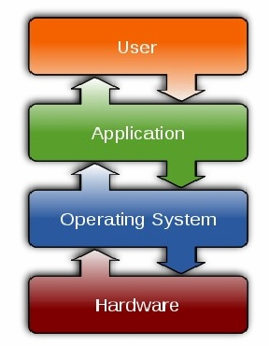
GUI
The graphical user interface (GUI /ɡuːiː/), is a type of user interface that allows users to interact with electronic devices through graphical icons and visual indicators such as secondary notation, instead of text-based user interfaces, typed command labels or text navigation.

Slide 12
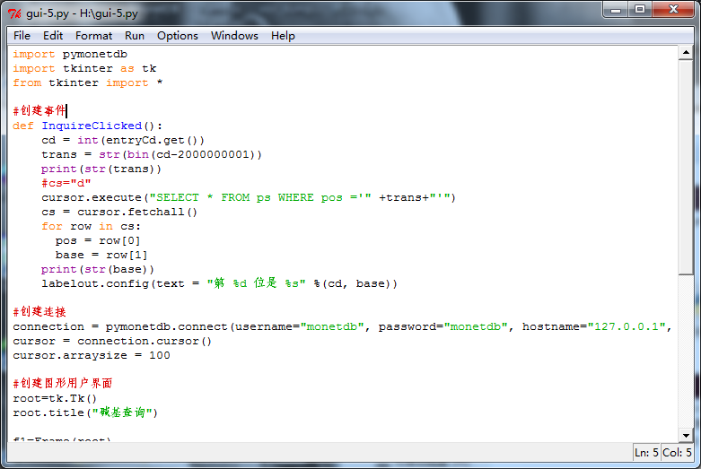
GUI

Slide 13
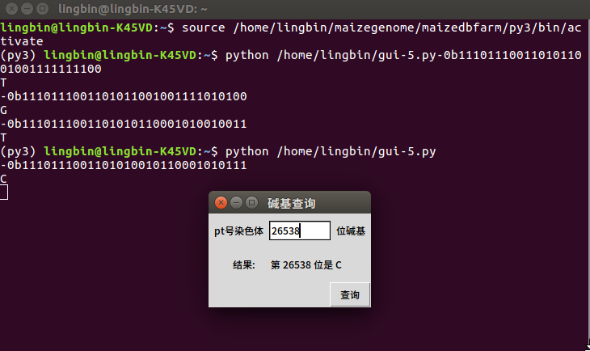
GUI

Slide 14
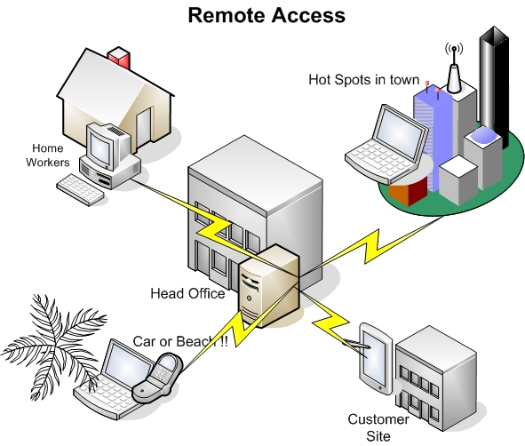
Prospect
Remote Access

Slide 15
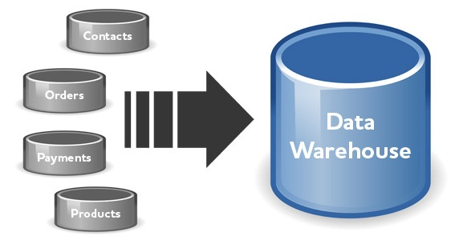
Prospect
Data Warehouse
A data warehouse is a subject-oriented, integrated, time-variant, and nonvolatile collection of data in support of management’s decision-making process.

Slide 16
Thanks!

